Slide 1
UI-desing
Katri Jylkkä, TIK22KM
Kevät 2022
Web-projektit
Responsiivisen verkkosivun suunnitelma

Slide 2
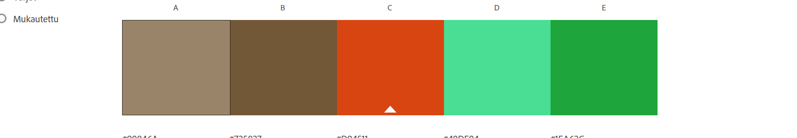
Colors of the site
Main color will fill items of the site, for example navbar and grid items. Color is sand-like but light enough so it doesn’t hide text inside of it which is black
Background- color will be light and calm, maybe some neutral/slightly warm white shade
Filler colors should bring neutral and natural feeling, in this point I think shades which bring natural and fresh feeling to viewer. For example different shades of green, brown and white. Red was succested for effect color in this point and it might be useable in some details maybe…
Last I will add color world which ”Example customer” to have her own massage business site
Main color
Example
Background color behind the items
Example color palette
The initial idea of ​​the colors which I like to have:

Slide 3
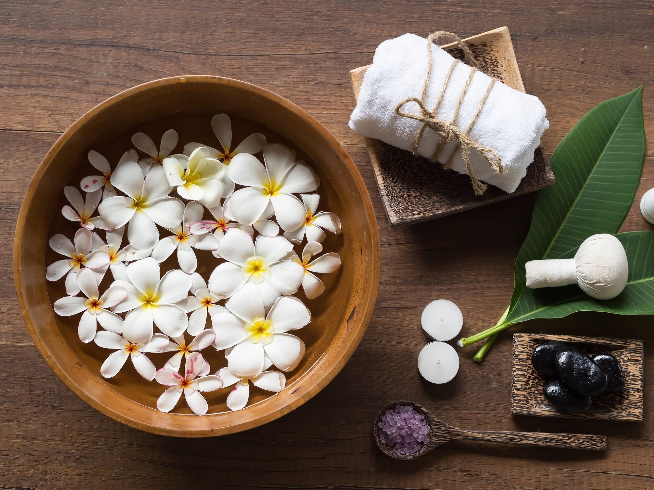
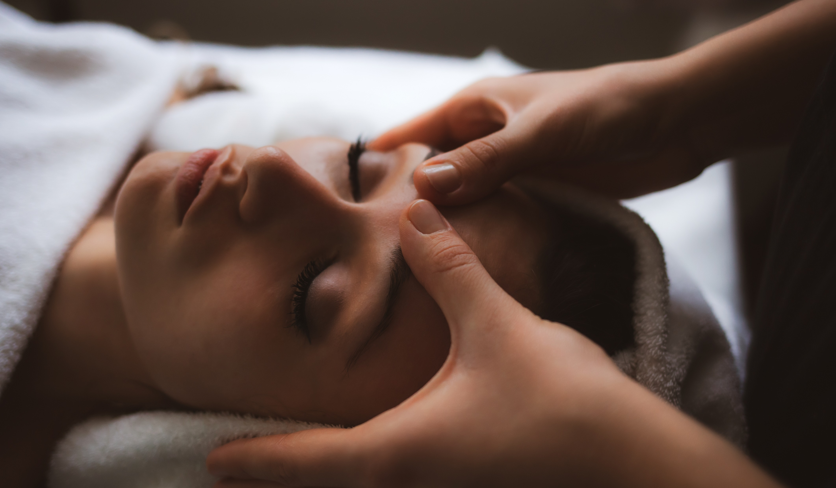
Yrityksen Nimi tähän
Sivu
Sivu
Sivu
Sivu
SIVU
Navbar
Links to different sites in navbar
Example Image in frontpage
Example
image
Text area for
content
Text area
Infobar For
Contact
information
Yhteystiedot/ Info

Slide 4

Yrityksen Nimi
Navbar in mobile view
Sivun otsikko tähän
Text area (mobile)
Infibar (mobile)

